Slide 1
Voices Above the Violence
Jennifer Gardiner

Slide 2
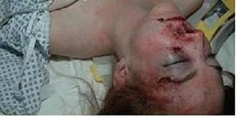
..
The night that changed my life

Slide 3
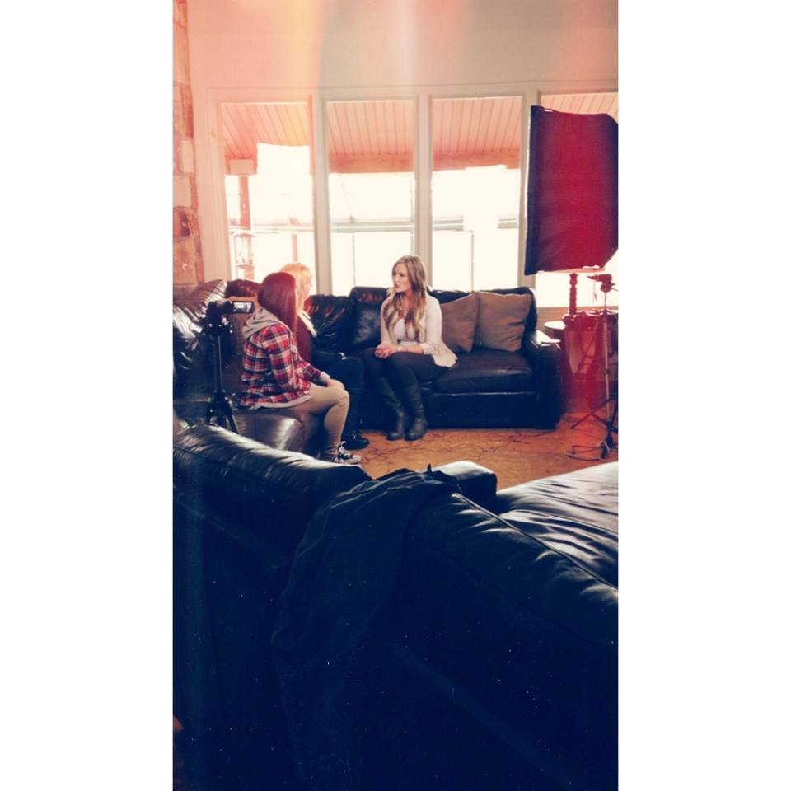
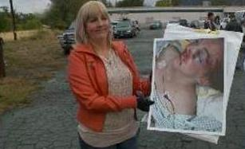
Spreading awareness
Guest Speaking in Tooele .. Interview with Fox 13
Filming of new “Living Life” talk show

Slide 4
Awareness on the rise
Notes:
Dr Phil’s campaign to end domestic violence

Slide 5
Robin McGraw
Her fight to stop abuse

Slide 6
HELP FOR ABUSERS
Family Violence Intervention Programs
About Family Violence Intervention Programs (FVIP)
What to Say to A Friend That’s Abusive
Have Important Conversations
What Can You Say or Do?
Draw attention to it.
Express ideas about loving behavior.
Offer suggestions or solutions.
If the abuser’s behavior is criminal, mention it.

Slide 7
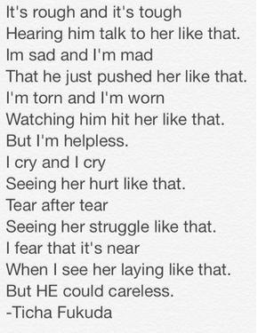
The effects on children
Notes:
Ticha poem

Slide 8
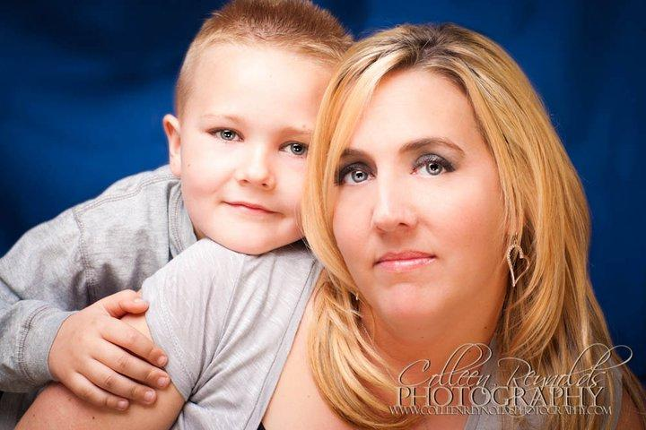
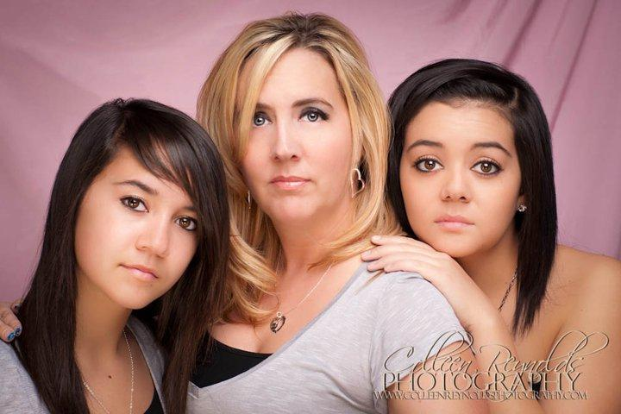
Why I am doing this….
My son deserves a chance
My girls deserve better

